Slide 1
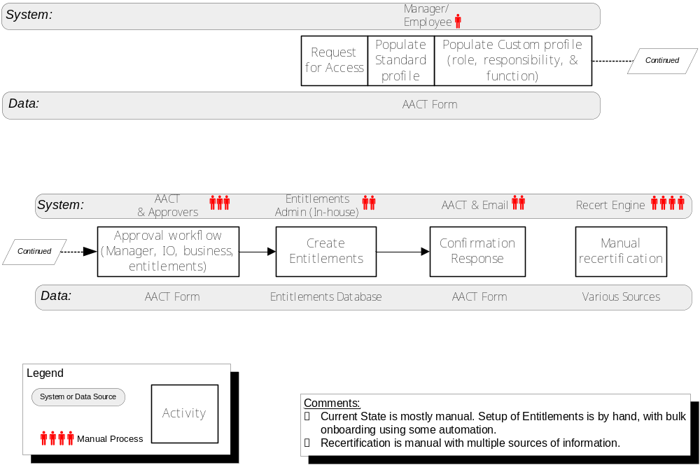
End to End Roadmap: Current State

Slide 2
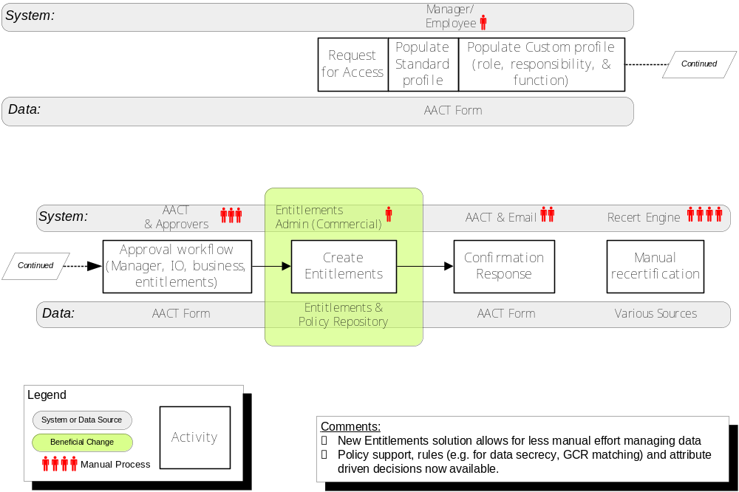
End to End Roadmap: Phase 1, Q106

Slide 3
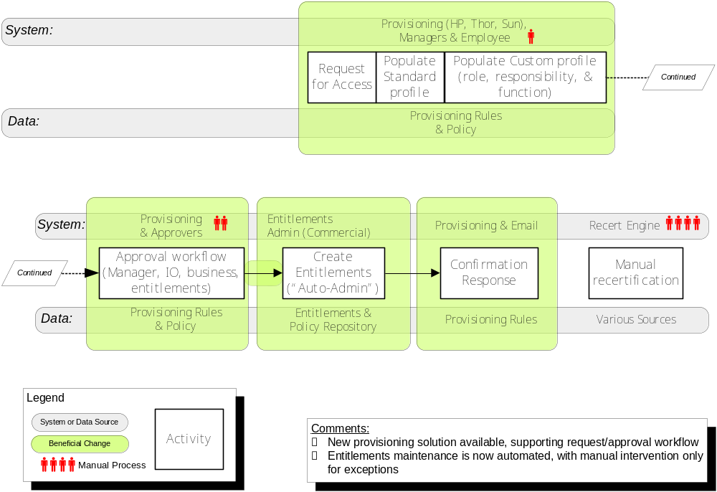
End to End Roadmap: Phase 2

Slide 4
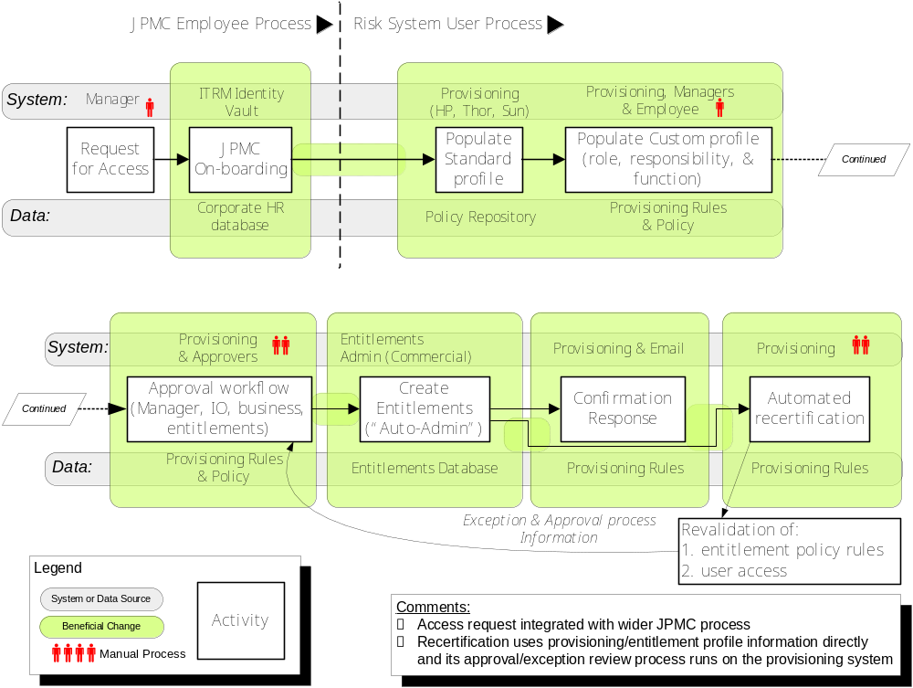
End to End Roadmap: Phase 3 (Final)

